Slide 1
Pricing Optimization at Bosch: A Business Analytics Approach
Final Business Analytics Project
Godsway Akakpo
30th September 2024

Slide 2

Introduction
-Bosch is a global engineering and technology leader known for its vast range of products, from home appliances to automotive parts. In such a competitive market, effective pricing strategies are critical to maximize profitability while maintaining market share (Bosch Global, 2024).
- In this presentation, i will explore how business analytics, using key data points, can help Bosch optimize its product pricing.

Slide 3
Problem Statement
Bosch currently face stiff competition in the market from competitors that provide similar products and also offer lower prices for their products.
It is essential for Bosch to optimize its pricing strategies so as to maximize revenue and profitability as well as remain very competitive in the market.
Notes:
Bosch is seeking to optimize its product pricing to maximize revenue while staying competitive. Key factors to consider include demand elasticity, competitor pricing strategies, and customer behavior.

Slide 4
Dataset Overview
Data needed for the project includes; Sales History, Competitor pricing and customer preference.
The was cleaned and missing values inputted, outliers identified and handled to ensure the data is ready for analysis.
Notes:
To develop a solution, i collected data on Bosch’s sales history, competitor pricing, and customer preferences. Data preprocessing was a crucial step, ensuring that our dataset was clean and ready for analysis. This included handling missing values, integrating data from different sources, and engineering new features for better prediction accuracy

Slide 5
Analytical Approach and Methodologies
ElasticNet: This is a model used to identify factors that influences the price of products of Bostch. This is done by combining two techniques (Lasso and Ridge) to ensure predictions are very reliable without getting overwhelmed by unnecessary details.
Random Forest Model: This model makes decision by combining many smaller decisions made by customers in deciding whether they will churn or not. Each small decision by a customer is used to create a tree and the final decision is based on the majority vote from all the trees as to whether the customer will churn or not.
XGBoost Model: This model makes simple predictions based on the available data and tries to fine-tune the accuracy of the prediction by focusing on the arears it went wrong
Notes:
Three ML models were used in this analysis.
ElasticNet model
Random Forest model
XGBoost model

Slide 6
Model Development
Key variables of used in the model are;
Competitor Pricing
Product price
Historical Price
Notes:
In the model development, i focused on key variables such as product pricing, historical demand, and competitor pricing. Through feature engineering, i created additional variables like price-to-demand ratios, competitor pricing gaps, and customer purchasing frequency. These features significantly improved the model’s ability to predict optimal pricing points.

Slide 7
Model Evaluation and Testing
The models were evaluated using the Root Mean Squared Error (RMSE) and R-Squared.
Cross validated was also conducted on the results to ensure the model generalizes well across different dataset.
Notes:
Once the model was developed, i evaluated its performance using metrics such as Root Mean Squared Error (RMSE) and R-squared. These metrics help us measure the model’s accuracy and its ability to explain the variability in demand based on pricing. We also implemented cross-validation to ensure that our model generalizes well across different datasets

Slide 8
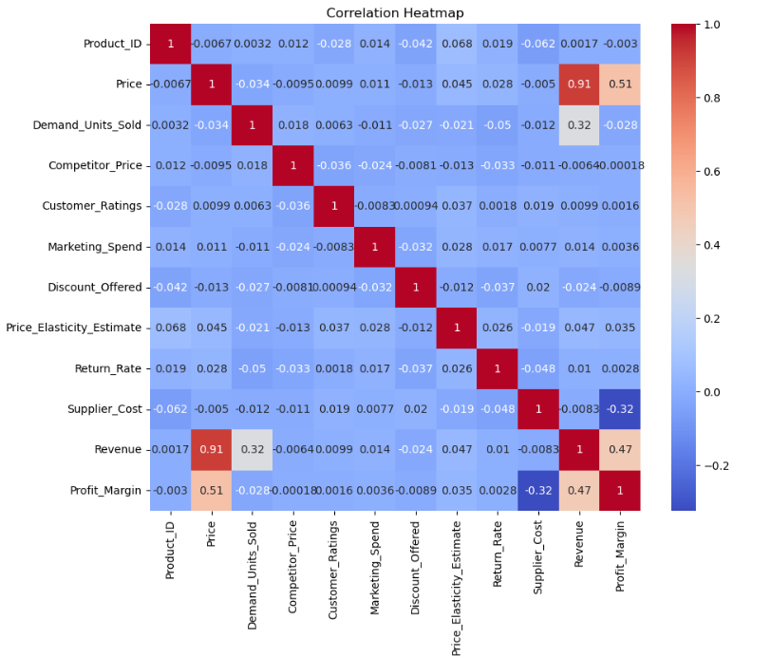

Slide 9
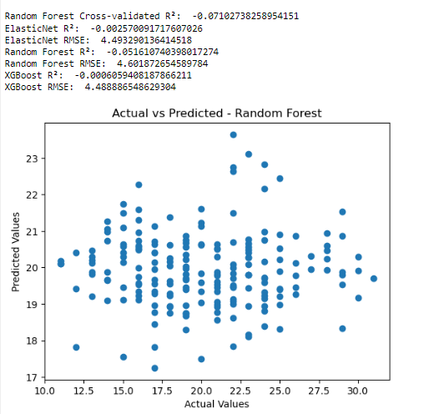

Slide 10
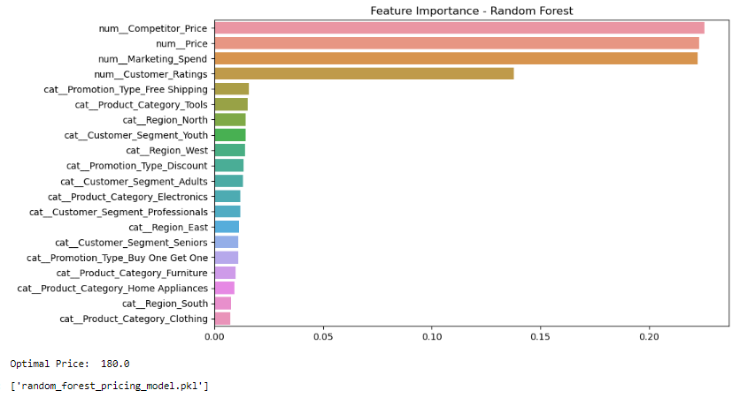

Slide 11
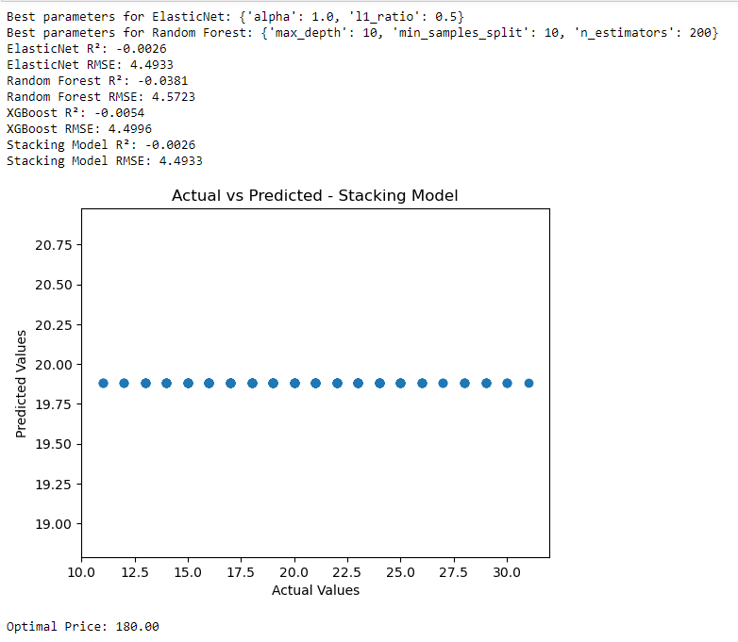

Slide 12
Key Findings and Insights
Supplier Cost and Profit Margin: Higher supplier costs tend to reduce profit margins.
The XGBoost model performed better from the three models used on the dataset.
Price and Revenue: As the price increases, revenue tends to increase.
Demand Units Sold and Revenue: When more units are sold, revenue increases.
Supplier Cost and Revenue: Higher supplier costs generally lead to lower revenue.
Price and Demand Units Sold: As the price increases, the number of units sold tends to decrease.
Discount Offered and Revenue: There is a weak negative correlation between Discount Offered and Revenue. This might indicate that offering discounts can sometimes lead to a slight decrease in revenue, possibly due to reduced profit margins.
Notes:
One of the key insights from the model is that certain Bosch products are more sensitive to price changes than others, indicating high price elasticity. For these products, small price reductions could significantly increase demand. Conversely, some high-end products showed inelastic demand, meaning pricing could be adjusted without impacting sales volume (Prashasti, 2024).

Slide 13
Pricing Optimization Strategy
Price adjustment by product segment
High-demand, high-price sensitivity segment
Low-demand, low-price sensitivity segment
Low demand, High-price sensitivity segment
Notes:
Based on the model’s findings, i propose a segmented pricing strategy. For price-sensitive products, i recommend adjusting prices downward during peak demand periods or in response to competitor price drops. For inelastic, premium products, i suggest maintaining higher price points to maximize revenue without losing market share (Mahapatra, 2023).

Slide 14
Implementation Plan
SN | Strategy | Details | Timeline | Status
1 | Data Review & Validation | Data collection Data validation with key stakeholders | Week 1 | Completed
2 | Price Segmentation | Segment products Set pricing objectives Develop price adjustments | Week 2 | Completed
3 | Alignment & Communication | Seek approval from Stakeholders Training & Communication | Week 3 | Completed
4 | Pilot & Testing Phase | Pilot price changes on selected products Monitor Performance Adjust price based on feedback | Week 4 - 5 | Completed
5. | Full Scale Rollout | Expand the rollout Implement Pricing automation Monitor and adapt | Week 6 - 8 | Not Completed
6. | Performance Monitoring & Optimization | Ongoing Analysis Re-evaluation based on market conditions | Continuous | Continuous

Slide 15
Conclusion
In conclusion, the pricing optimization model developed provides Bosch with actionable insights into how it can adjust prices to maximize revenue. By leveraging data and analytics, Bosch can maintain a competitive edge, reduce the risk of overpricing or underpricing products, and ultimately drive profitability.

Slide 16
References
Bosch Global. (2024). Company Overview. Bosch Global. https://www.bosch.com/company/
Mahapatra, B. (2023, August 29). Pricing Optimization Solutions Are Becoming The Key To Revenue Maximization. Forrester. https://www.forrester.com/blogs/pricing-optimization-solutions-are-becoming-the-key-to-revenue-maximization/
Prashasti. (2024, April 30). Driving Sales Growth Through Effective Price Optimization - Rubick.ai Driving Sales Growth Through Effective Price Optimization. Rubick.ai. https://rubick.ai/blog/pricing-intelligence/driving-sales-growth-through-effective-price-optimization/

